Slide 1
FIT YOU
Name | UIN | Seat Number
Tushar Kadam | 201S010 | 22DRECS5016
Tushar Vaishya | 201S005 | 22DRECS5011
Maseera Sayed | 212S008 | 22DRECS5009
Swaraj Patil | 201S018 | 22DRECS5006

Slide 2
Introduction

Slide 3
Literature Survey
How important is exercise for you???
How often do you exercise?
What forms of exercises do you currently participate in?
Would you say you eat a healthy balanced diet??
How many serves of fruits do you usually eat each day?

Slide 4
Software Requirements
IDE
Internet Programming Languages
Web Server
Software Requirements
Browser Requirements

Slide 5
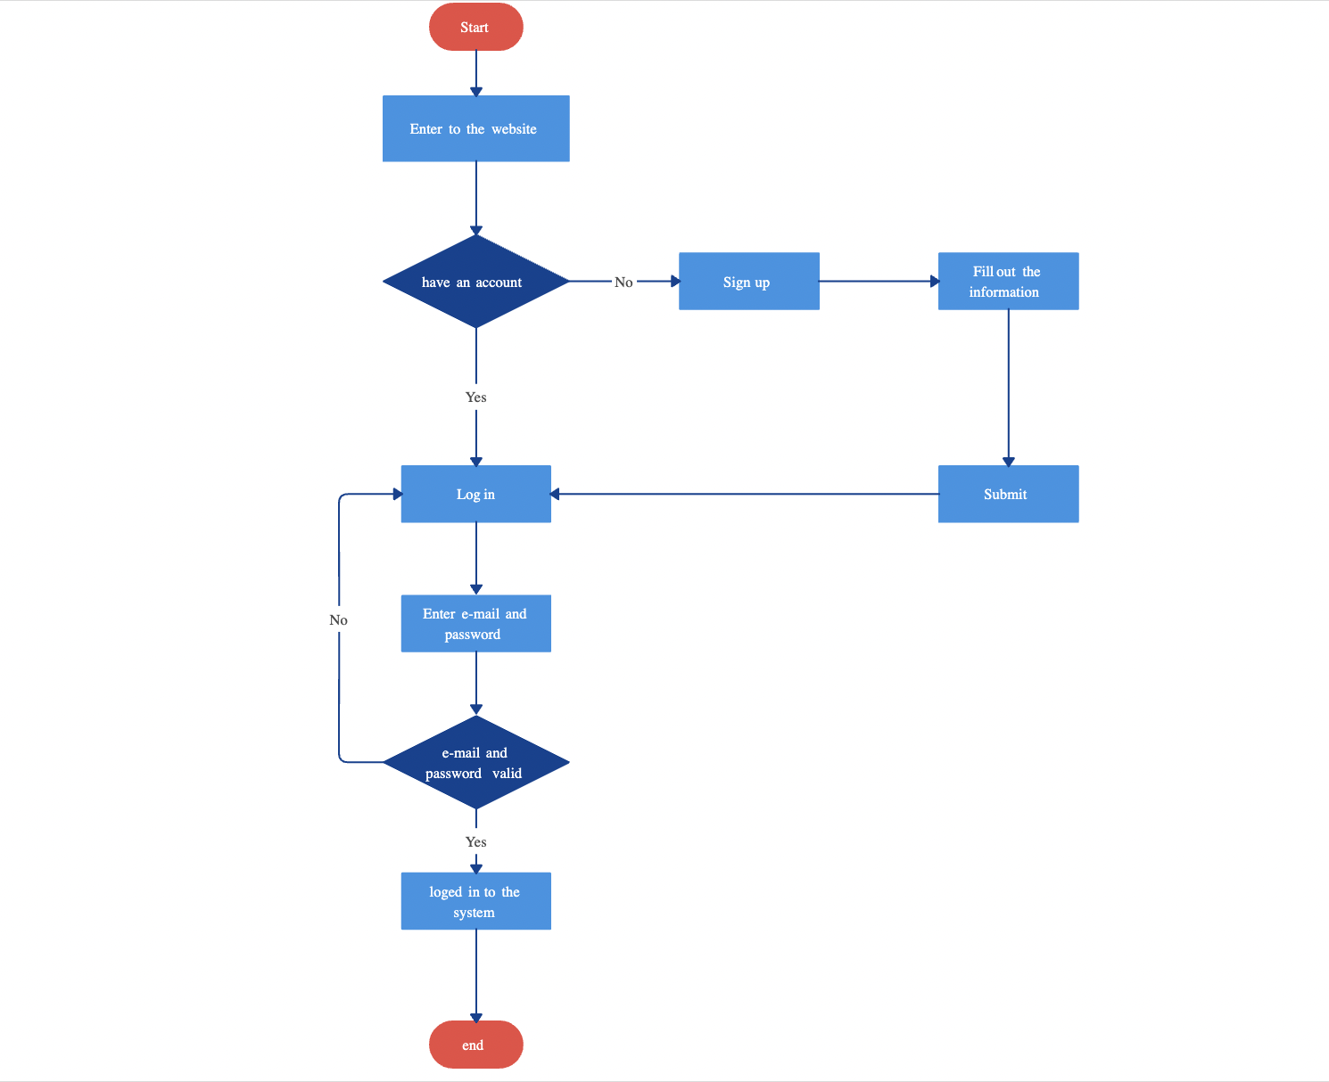
Methodology
Flowchart

Slide 6
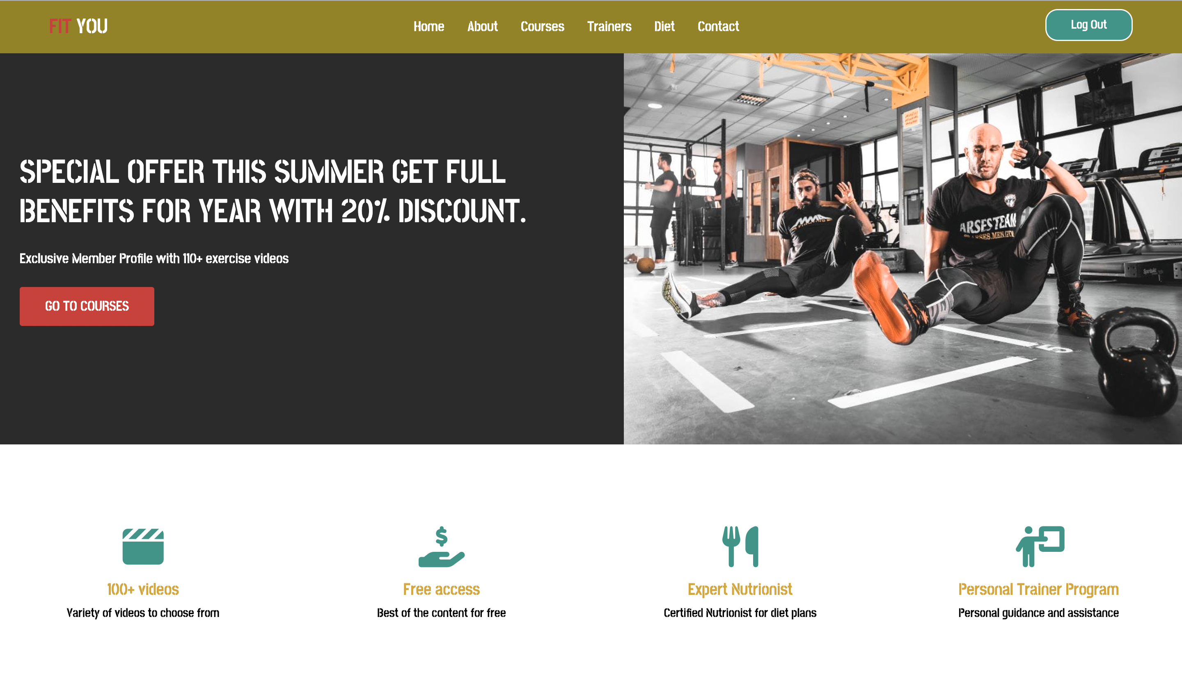
Home Page

Slide 7

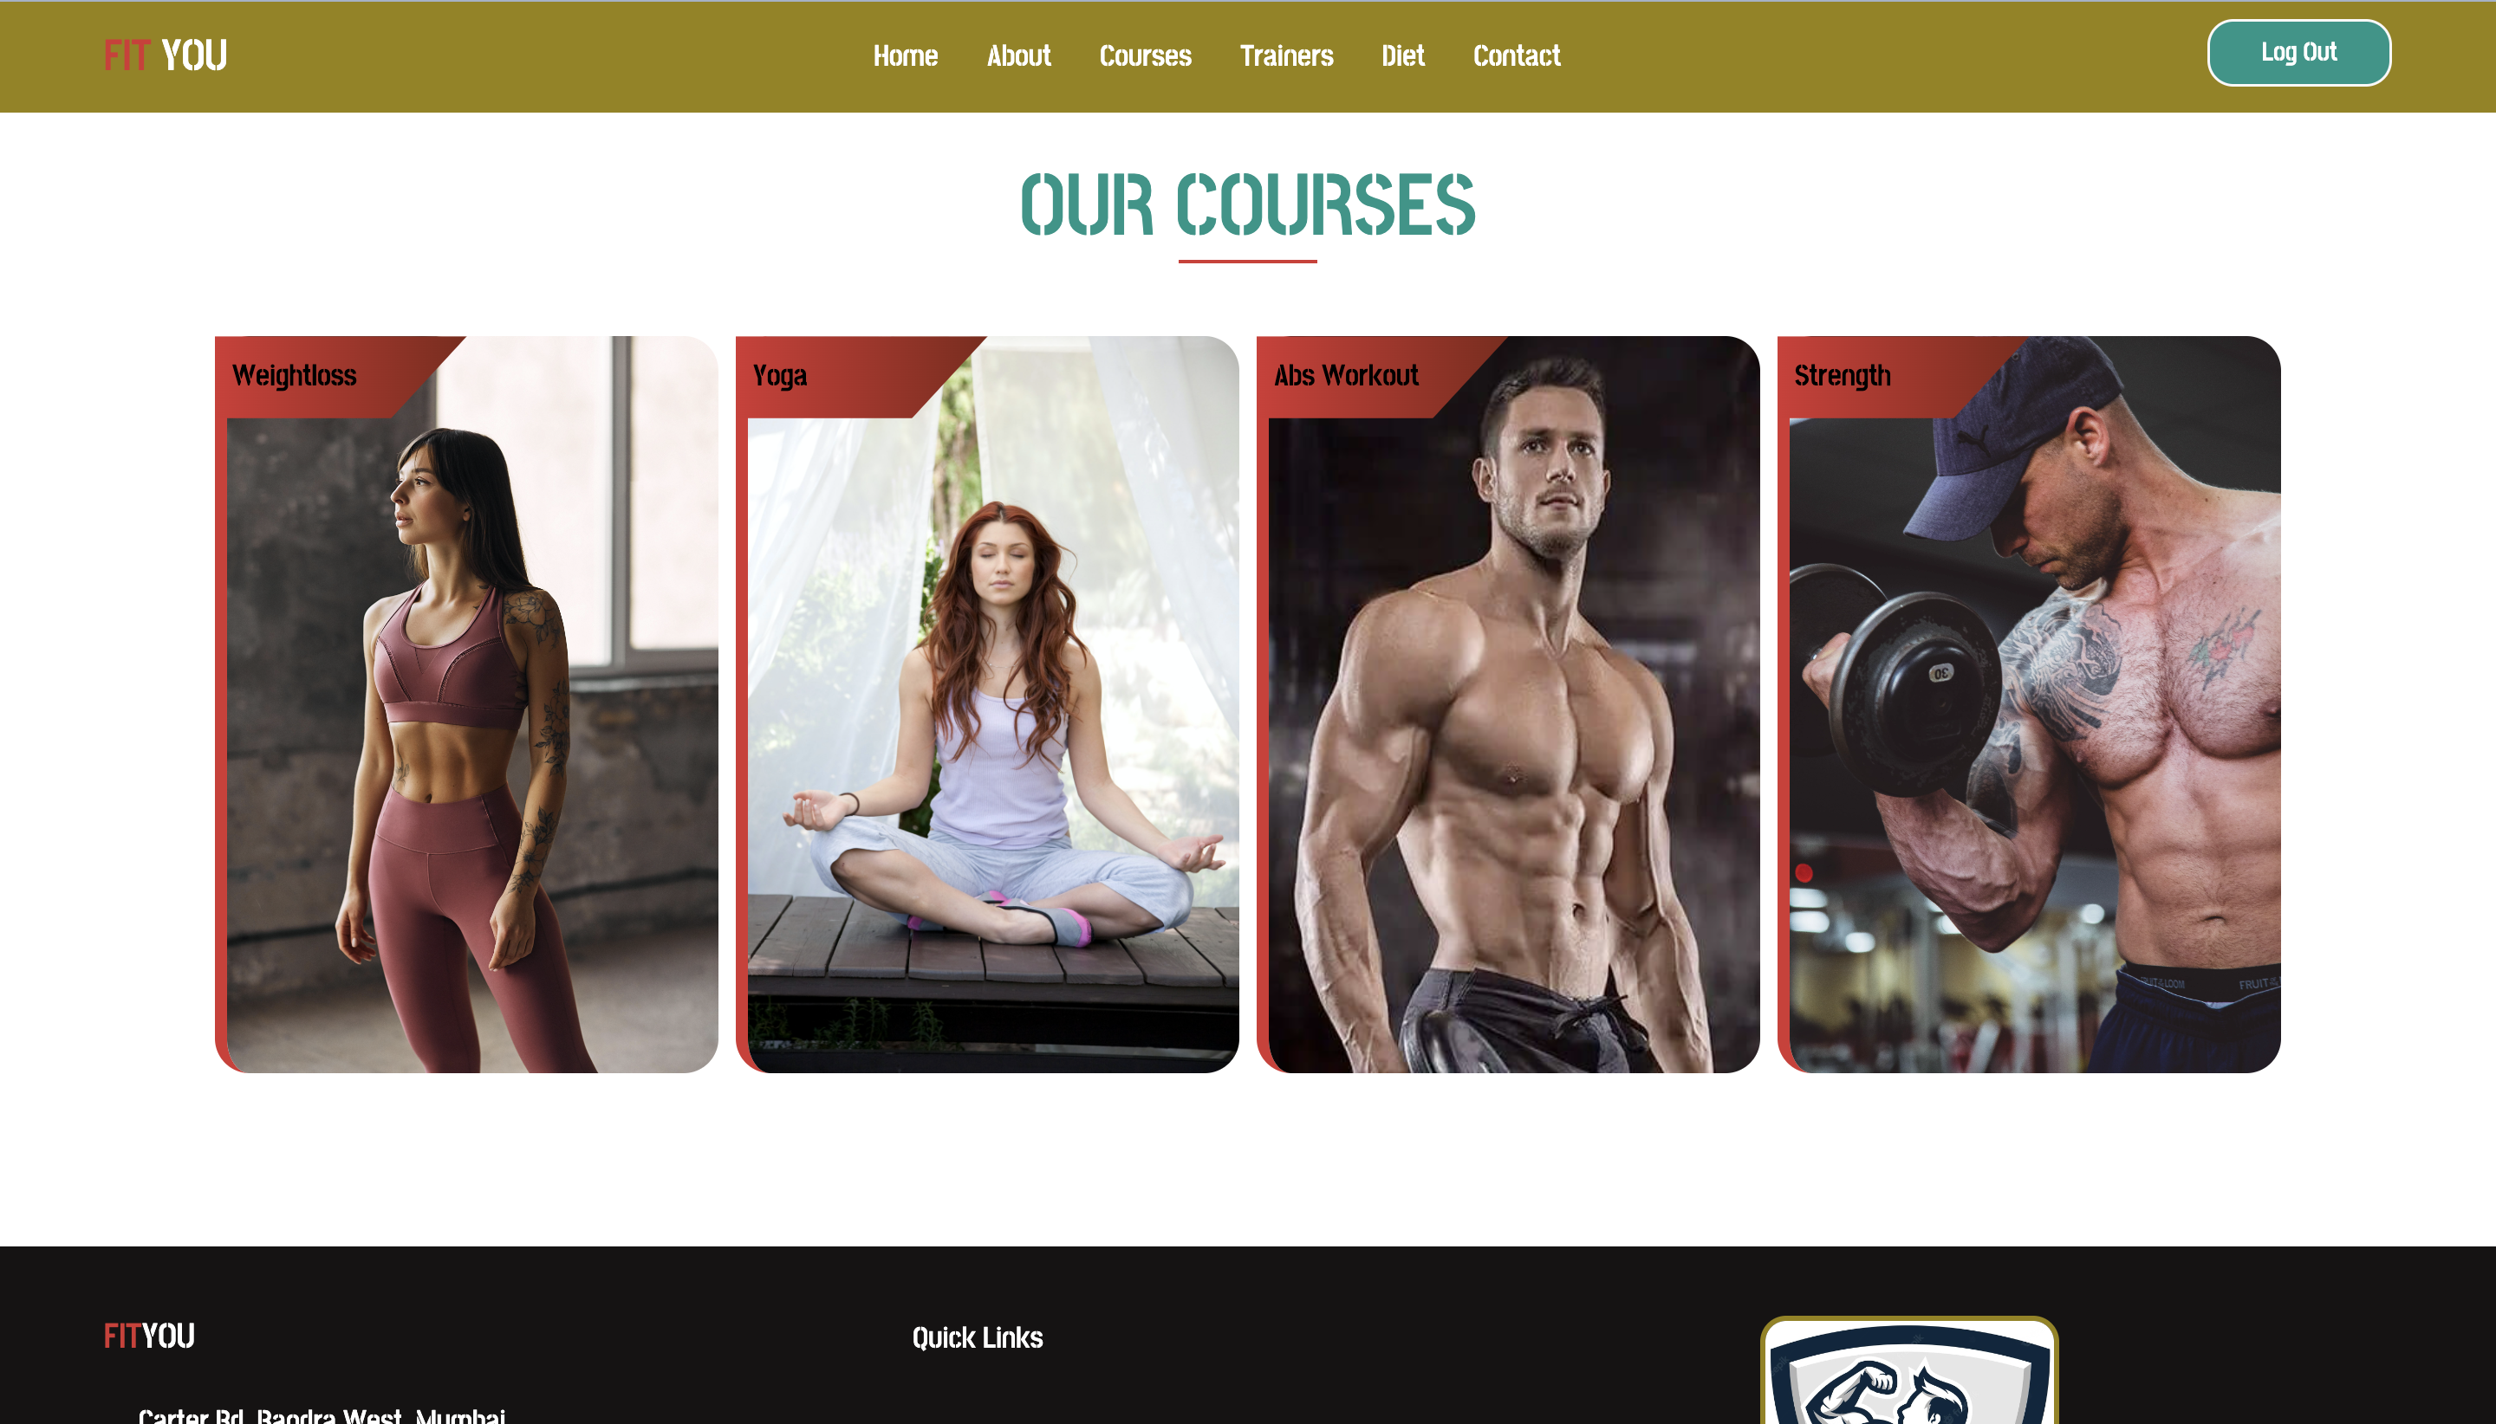
Course Page

Slide 8
Advantages
Free Workout with different forms of workout
Personalised diet plan
Easy access
Free of cost
More private than the gym
Give Free Health and Fitness Tips

Slide 9
Features and Applications
Excess of Videos(For.eg Yoga, Weightless, etc)
Provide Diet Plan
Provide Personal Trainer
Use for becoming fit
Upgrade Lifestyle

Slide 10
Conclusion
This will be the only website where user can get each and every type of thing which can make their life healthy and beautiful.
Good idea on developing a user-friendly application
Enables the user to use it without any inconvenience

Slide 11
Thank You!!!

